Slide 1
Management of Iron Deficiency in Heart Failure : Current Evidence and Practical Recommendations for the use of Ferric Carboxymaltose
J. Parissis
Heart Failure Unit,
Attikon University Hospital,
Athens, Greece

Slide 2
Disclosures
Grants: ALARM investigator received research grants by Abbott US and Orion Pharma
Horonaria: received horonaria for advisory boards and lectures from Novartis, Pfizer, Menarini, Servier , Roche diagnostics and Genesis Pharma
Journals: Associate Editor of EJHF
ESC HF GLs: Member of task force

Slide 3
Case summary
History:
67 year-old female
3-year history of HF due to drug-induced dilated cardiomyopathy (LVEF: 30%) (history of breast cancer on doxorubicin)
Presentation:
NYHA II
Body weight 73 Kgs
NT-proBNP: 1015 pg/ml
SBP 110/60mm Hg
HR 66/min
QRS duration: 115 ms
6 min Walking Distance: 360 meters
GFR: 62 ml/min
HB: 10,9 mg/dl

Slide 4
Chronic management
Oral medications
Sacubitril/Valsartan 200 mg bid
Bisoprolol 7,5 mg
Furosemide 80 mg
Eplerenone 50 mg
ICD
Management of co-morbidities
Evaluation for transplantation/LVAD implantation

Slide 5
Pt was Investigated for iron deficiency
Diagnostic work-up for anemia
History, lab test negative for malignancy
Iron deficiency (Ferritin=28 μg/L – TSAT=12%)
Folic acid, B12: normal
Gastrointestinal endoscopy: negative

Slide 6
Iron deficiency management
Fe deficit(mg)= = 1080mg
iv Fe administration
Ferric carvoxymaltose 1000mg (for 15 min). New administration of 500 mg after 6 weeks (ferritin: 88 μg/L)
Evaluation after 12, 24 weeks since therapy completion

Slide 7
8 weeks later
NYHA: I-II
6MWT: 400 meters
Laboratory tests:
Hb=12,1 mg/dL
Urea=60 mg/dL, Creatinine=1,3 mg/dL
Sodium=140 mEq/L, Potassium=4,1 mEq/L
BNP=501 pg/ml
Ferritin: 102 μg/dl

Slide 8
Etiology & pathophysiology of anemia in HF
Chronic
Inflammation
Anemia of
Chronic
Disease
Pharmaco-
therapy
Renal
Dysfunction
Decreased
Cardiac
Output
Malnutrition
Bone marrow dysfunction
Abnormal iron homeostasis (uptake, release, utilization)
Intravascular fluid imbalance (hemodilution)
EPO deficiency or resistance

Slide 9
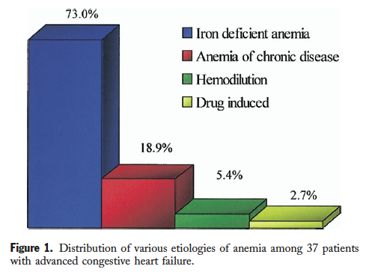
Etiology of anemia in advanced CHF
37 pts, advanced CHF, LVEF 25%
Iron deficiency: absence of iron stores in bone marrow
Hemodilution: Normal RBC volume by Cr-51 labeled RBC
Drug-induced: enalapril (restoration after discont.)
Chronic disease anemia: no specific cause found
Nanas et al, J Am Coll Cardiol 2006

Slide 11
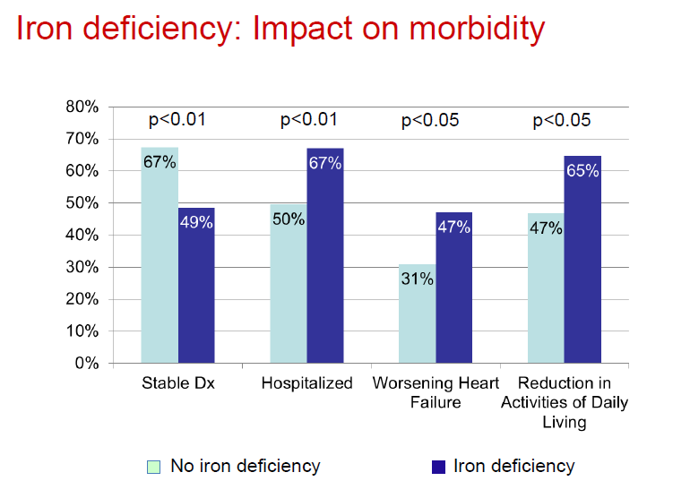

Slide 12
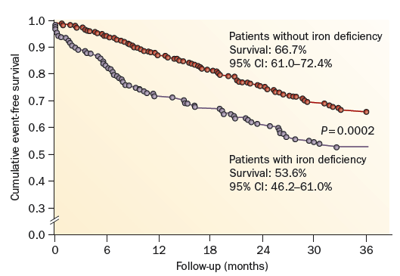
Iron deficiency in HF
546 CHF pts
Iron deficiency: ferritin <100 ng/mL or 100-300 ng/mL plus TSAT <20%
Jankowska et al, Eur Heart J 2010

Slide 13
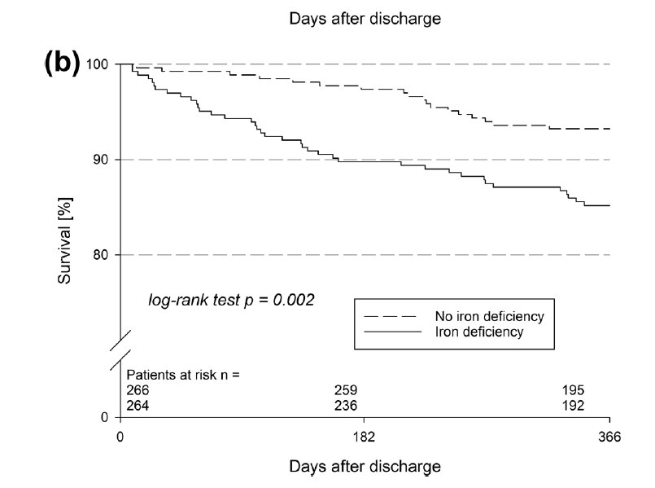

Slide 14
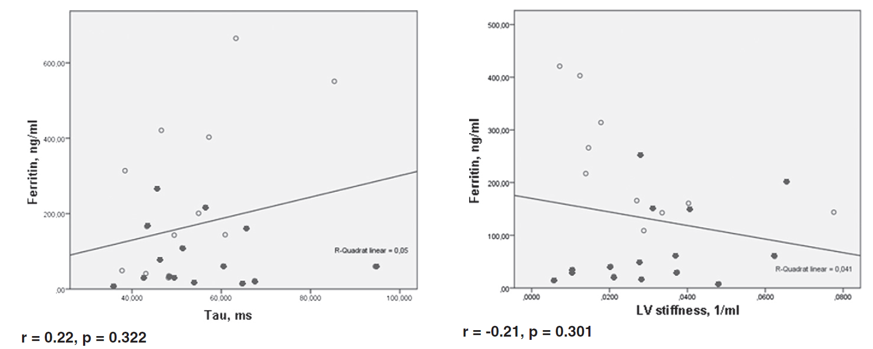
Functional iron deficiency and diastolic function in heart failure with preserved ejection fraction

Slide 16
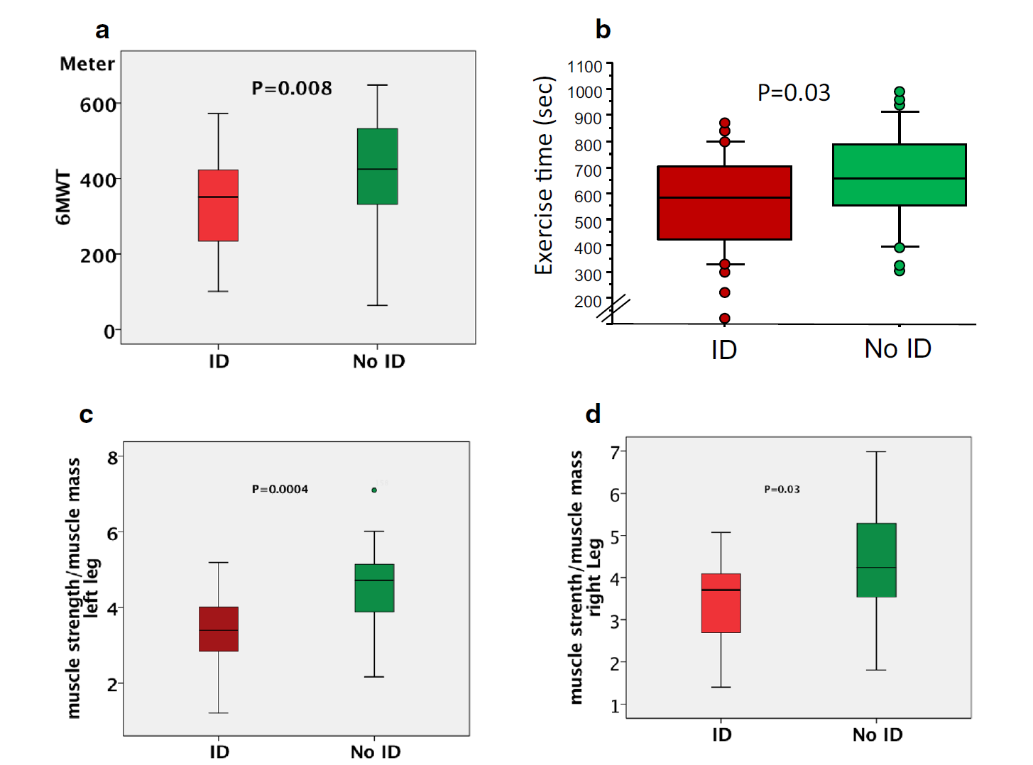

Slide 18
Depleted iron stores are associated with inspiratory muscle weakness independently of skeletal muscle mass in men with systolic chronic heart failure

Slide 21
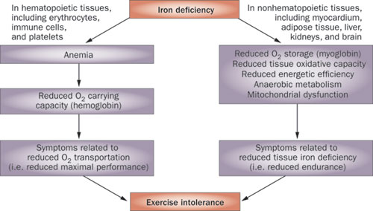
Role of iron deficiency in the pathogenesis of exercise intolerance
van Veldhuisen, D. J. et al. (2011) Anemia and iron deficiency in heart failure:
mechanisms and therapeutic approaches
Nat. Rev. Cardiol. doi:10.1038/nrcardio.2011.77

Slide 25
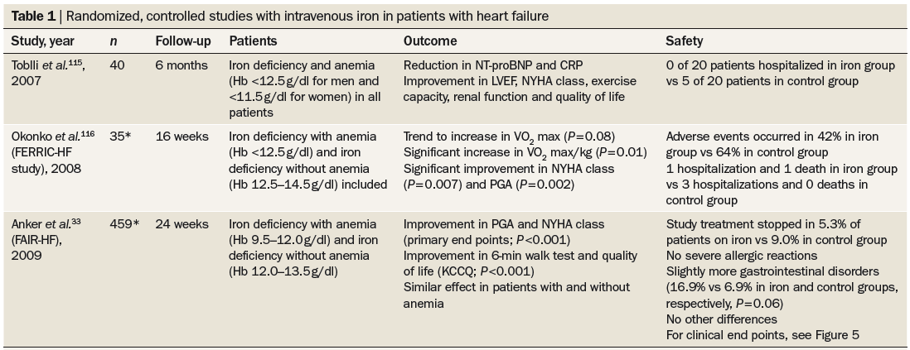
Clinical trials in iron repletion
van Veldhuisen et al, Nature Rev Cardiol 2011

Slide 26
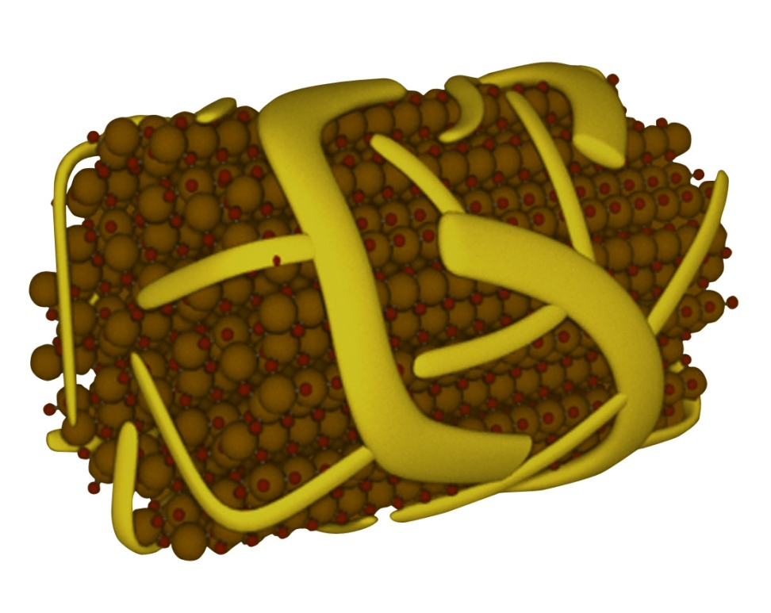
What is Ferric Carboxymaltose?
Stable polynuclear iron complex
Essentially no release of ionic iron in circulation
Dextran-free carbohydrate shell (low immunogenic potential)
No test dose
Physiological pH and osmolarity
Rapid administration of up to 1000 mg iron
Ferric hydroxide molecules
Ribbon-like carboxymaltose
Macdougall & Ashenden, Adv Chron Kid Dis 2009
Notes:
26

Slide 27
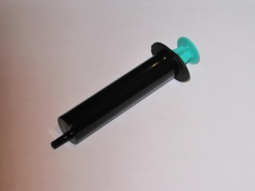
FAIR-HF study design Anker SD, Colet C, Filippatos G, et al. Eur J Heart Fail 2009;11:1084–91.
Main inclusion criteria:
NYHA class II/III, LVEF ≤40% (NYHA II) or ≤45% (NYHA III)
Hb: 9.5–13.5 g/dL
Iron deficiency: serum ferritin <100 µg/L or <300 µg/L, if TSAT <20%
Treatment adjustment algorithm:
Interruption: Hb >16 g/dL or serum ferritin >800 µg/L or serum ferritin >500 µg/L, if TSAT >50%
Restart: Hb <16 g/dL and serum ferritin <400 µg/L and TSAT<45%
Blinding:
Clinical staff: unblinded and blinded personnel
Patients: usage of curtains and black syringes for injections
* Total dose required for repletion calculated using the Ganzoni formula
FAIR-HF=Ferric carboxymaltose Assessment in patients with IRon deficiency and chronic Heart Failure; Hb=haemoglobin; i.v.=intravenous; LVEF=left ventricular ejection volume; NYHA=New York Heart Association; PGA=patient global assessment; TSAT=transferrin saturation

Slide 28
Primary and secondary endpoints in FAIR-HF
Primary:
Self-reported Patient Global Assessment score at week 24
NYHA class at week 24 (adjusted for baseline NYHA class)
Key secondary
PGA score and NYHA class* at Weeks 4 and 12
Six-minute walk test distance**
KCCQ score**
EQ-5D questionnaire score**
Safety endpoints
* adjusted for baseline
**at weeks 4, 12 and 24 and adjusted for baseline
EQ-5D=European Quality of Life-5; KCCQ=Kansas City Cardiomyopathy Questionnaire
Anker SD, et al. Eur J Heart Fail 2009;11:1084–91.

Slide 29
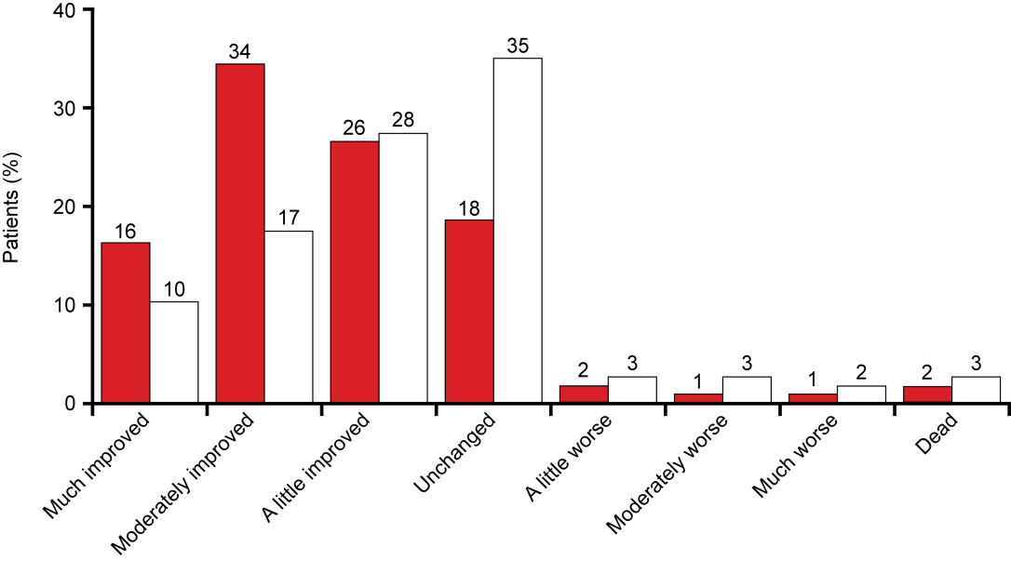
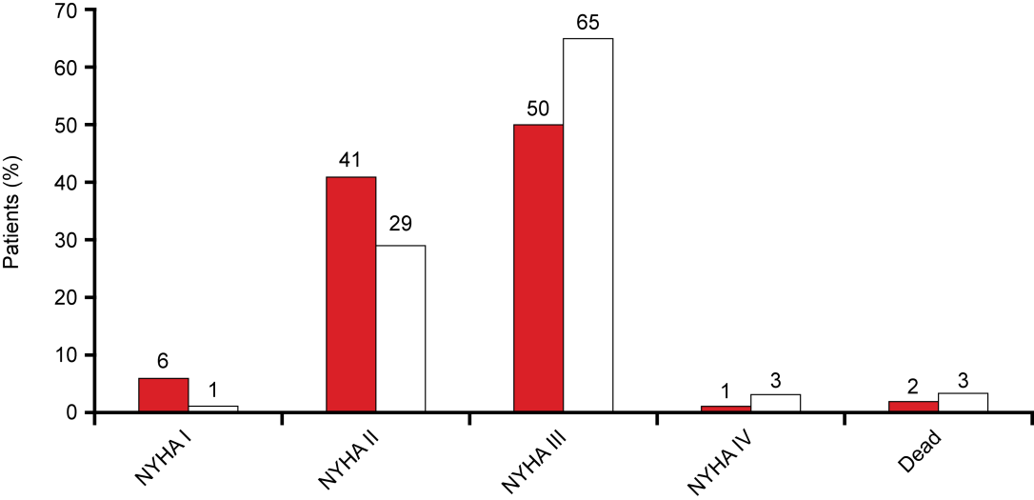
Intravenous iron in CHF FAIR-HF: Primary endpoints
Patient Global Assessment at Week 24
OR for better rank: 2.51 p<0.001
459 pts, NYHA II-III, LVEF<45%, with iron deficiency (ferritin <100 ng/mL or 100-299 if TSAT <20%)
Ferric carboxymaltose iv 200mg/week to iron repletion, then 200mg/month vs placebo
NYHA Functional Class at Week 24
OR for improvement by 1 class: 2.40 p<0.001
Anker et al. N Engl J Med 2009

Slide 30
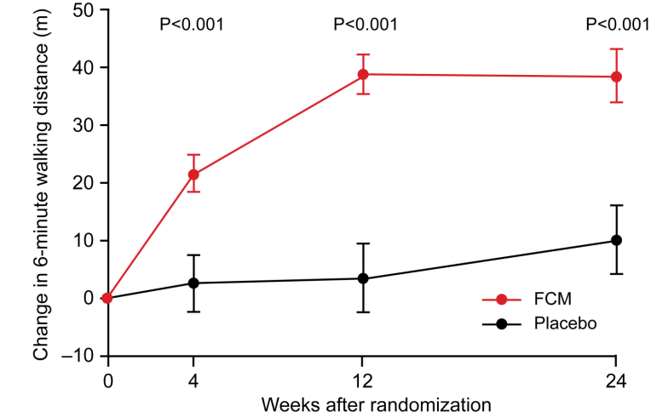
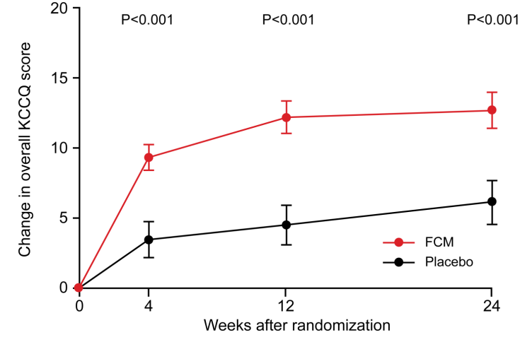
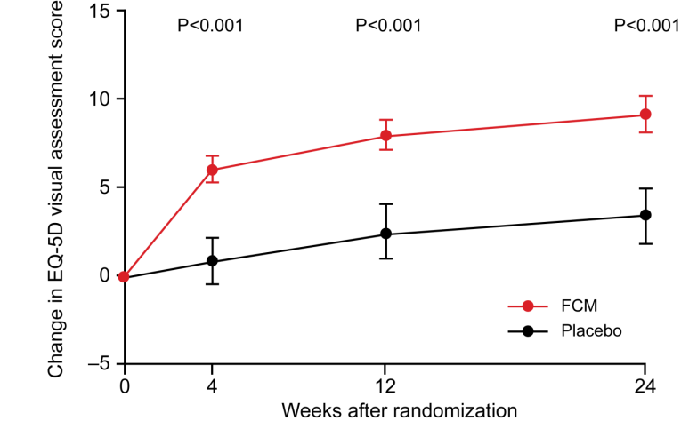
Intravenous iron in CHF FAIR-HF: secondary endpoints
6-minute walk test
KCCQ overall score
EQ-5D VAS score
p<0.001
p<0.001
p<0.001
p<0.001
p<0.001
p<0.001
Anker et al. N Engl J Med 2009

Slide 31
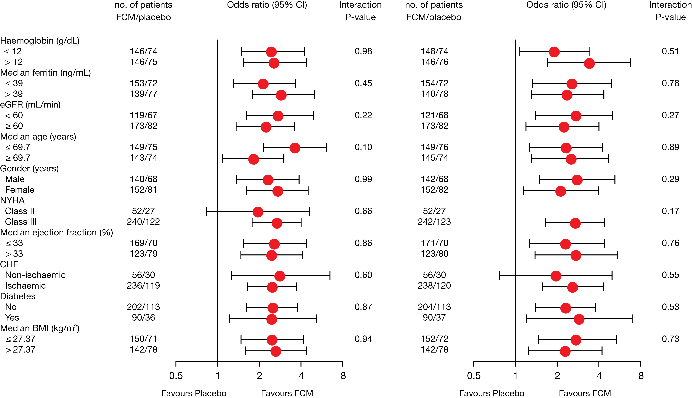
FAIR-HF results: intravenous iron performed better than placebo in all patient subgroups
Patient Global Assessment
NYHA functional class
Haemoglobin (g/dL)
≤12
>12
Median serum ferritin (μg/L)
≤39
>39
eGFR (mL/min/1.73 m²)
≤60
>60
Median age (years)
≤69.7
≥69.7
Gender
Male
Female
NYHA
Class II
Class III
Median ejection fraction (%)
≤33
>33
CHF
Non-ischaemic
Ischaemic
Diabetes
No
Yes
Median BMI (kg/m²)
≤27.37
>27.37
Anker SD, et al. N Engl J Med 2009;361:2436–48.
BMI=body mass index; CHF=chronic heart failure; eGFR=estimated glomerular filtration rate

Slide 32
Safety endpoints in FAIR-HF
 | Patients with events (Incidence per 100-patient years at risk)
 | FCM (N=305) | Placebo (N=154) | p
Death | 5 (3.4) | 4 (5.5) | 0.47
CV death | 4 (2.7) | 4 (5.5) | 0.31
Death due to worsening HF | 0 (0.0) | 3 (4.1) | –
First hospitalisation | 25 (17.7) | 17 (24.8) | 0.30
Hospitalisation for any CV reason | 15 (10.4) | 14 (20.0) | 0.08
First hospitalisation for worsening HF | 6 (4.1) | 7 (9.7) | 0.11
Any hospitalisation or death | 30 (21.2) | 19 (27.7) | 0.38
Hospitalisation for any CV reason or death | 20 (13.9) | 16 (22.9) | 0.14
First hospitalisation for worsening HF or death | 11 (7.5) | 10 (13.9) | 0.15
CV=cardiovascular; HF=heart failure
Anker SD, et al. N Engl J Med 2009;361:2436–48.

Slide 33
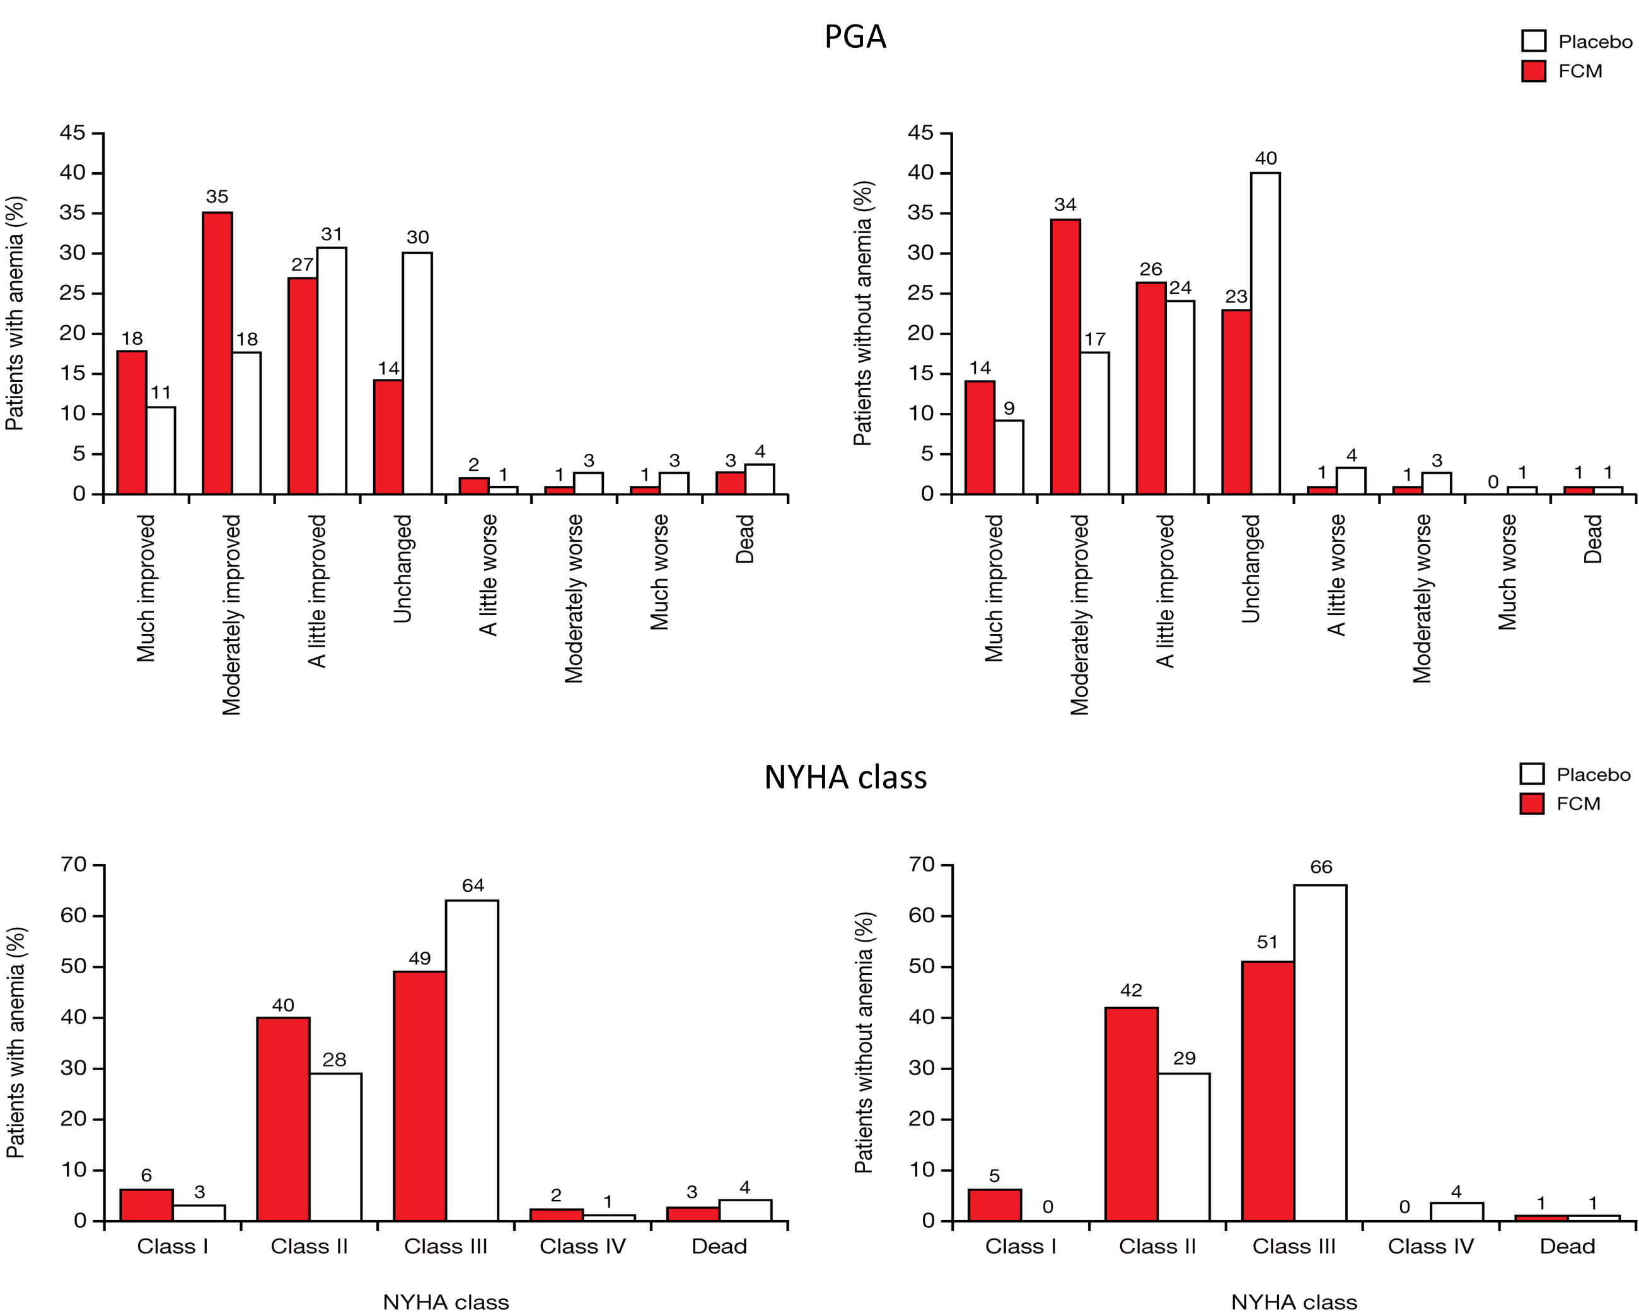
Intravenous iron in CHF FAIR-HF
Patients with anemia
Patients without anemia
%
%
Patients with anemia
Patients without anemia
%
%
Filippatos, Farmakis , Parissis , et al. Eur J Heart Fail 2013

Slide 34
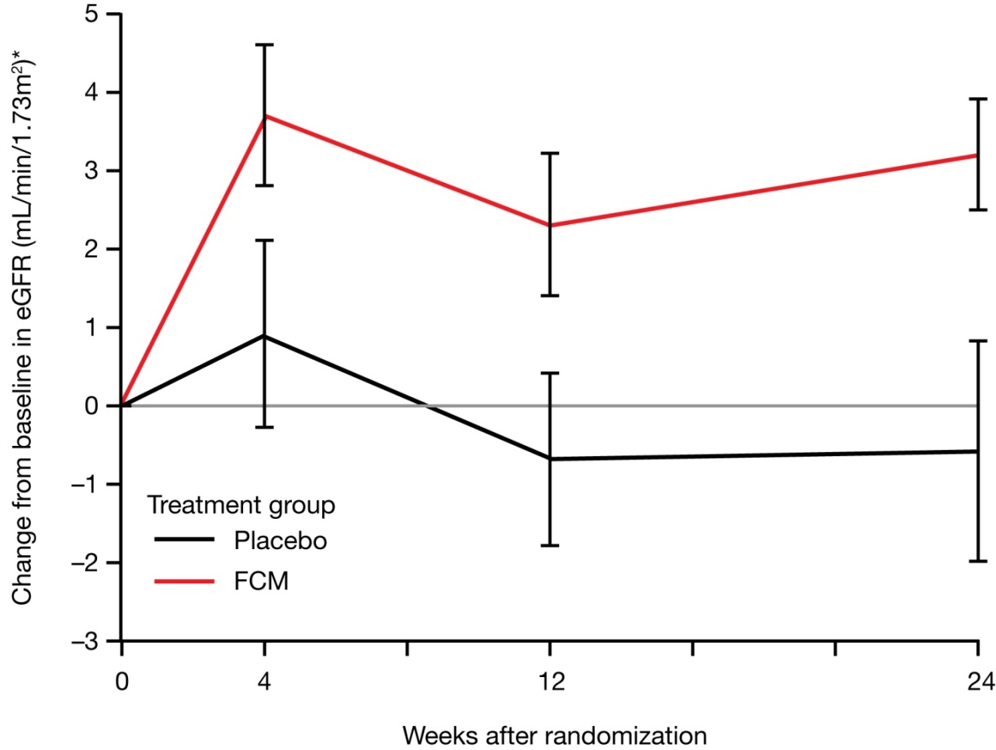
FAIR-HF results: impact of FCM on renal function
p=0.054
p=0.049
p=0.017
Treatment effect
(mL/min/1.73m²)*: 2.8 ± 1.5 3.0 ± 1.5 4.0 ± 1.7
*LSM mean ± SE; LSM=least squared mean
Ponikowski P, et al. Heart Failure Association Congress 2010; abstract 114 and late-breaking trial oral presentation.

Slide 35
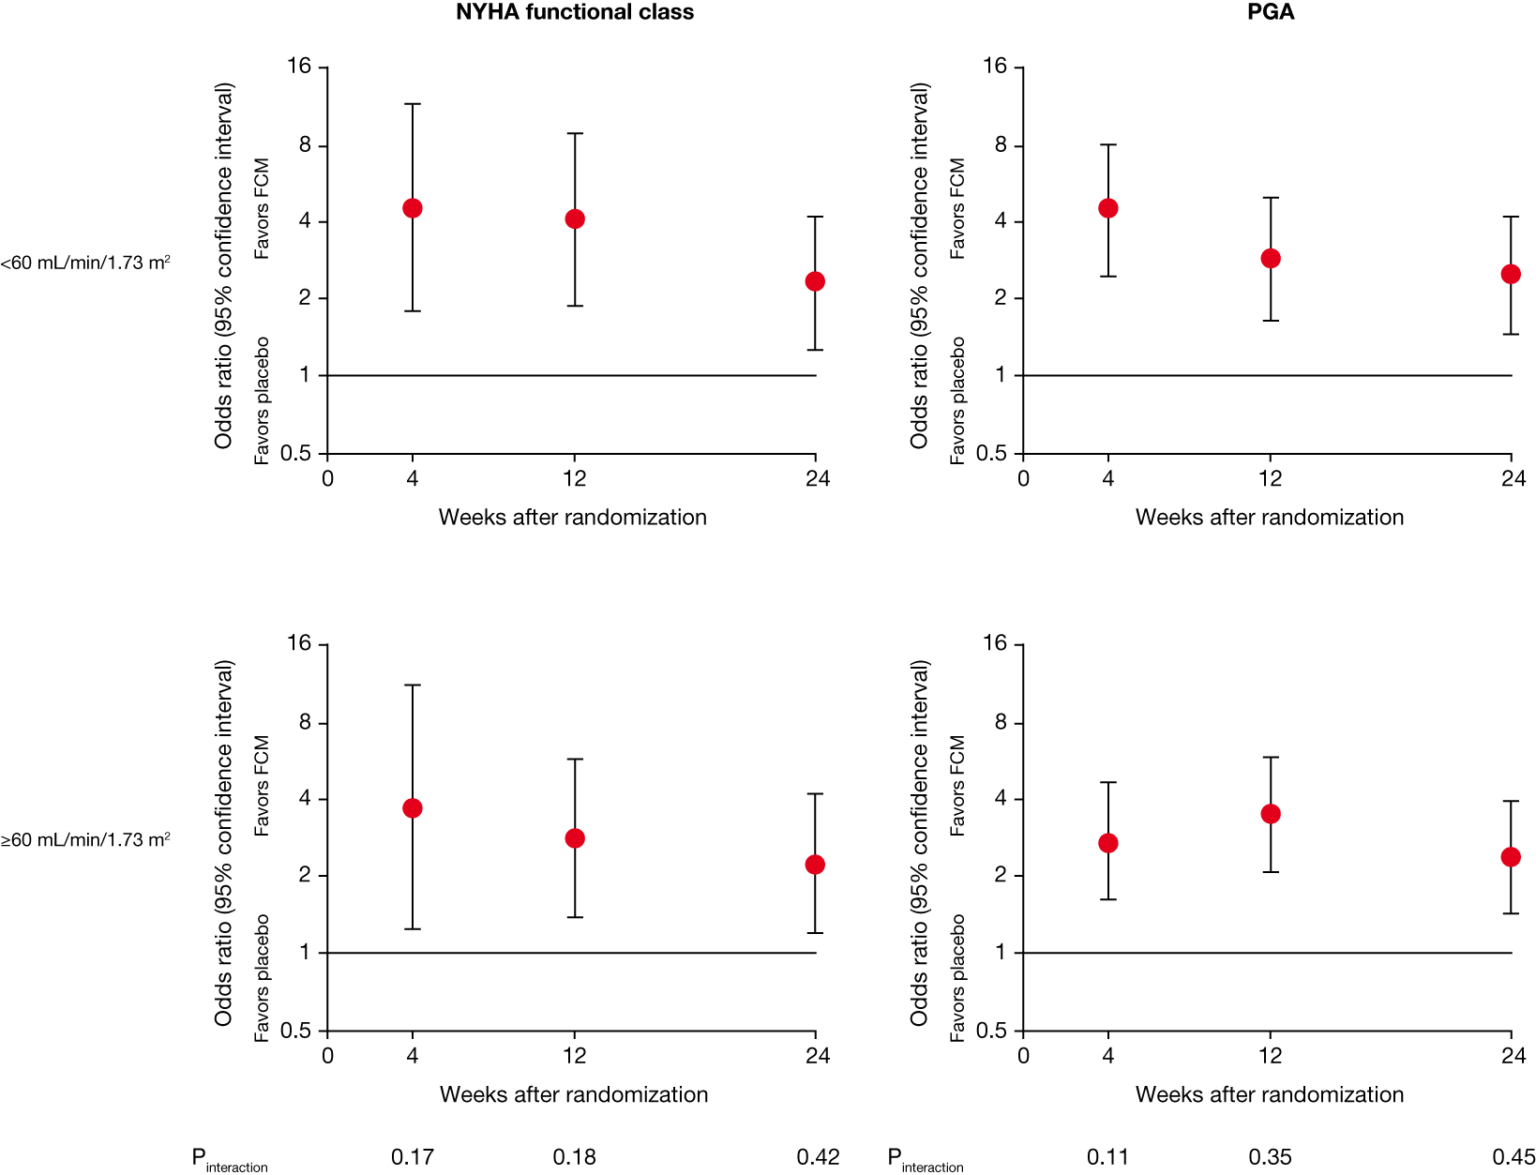
FAIR-HF results: primary endpoints by baseline eGFR
NYHA functional class
Patient Global Assessment
<60 mL/min/1.73 m²
≥60 mL/min/1.73 m²
P_{Interaction} 0.17 0.18 0.42
P_{Interaction} 0.11 0.85 0.46
Ponikowski P, et al. Heart Failure Association Congress 2010; abstract 114 and late-breaking trial oral presentation.

Slide 36
CONFIRM-HF Change in 6-min walk test (Primary endpoint)
30
P=0.002
20
FCM (N=150)
Placebo (N=151)
10
LSM change in 6MWT distance
from baseline (m)
0
-10
-20
-30
Week 24

Slide 37
CONFIRM-HF First hospitalization due to worsening HF
30
Log–rank test P=0.009
20
Placebo
Hospitalization rate
(per 100 subjects)
10
FCM
0
0
90
180
270
360
Time (days)

Slide 40
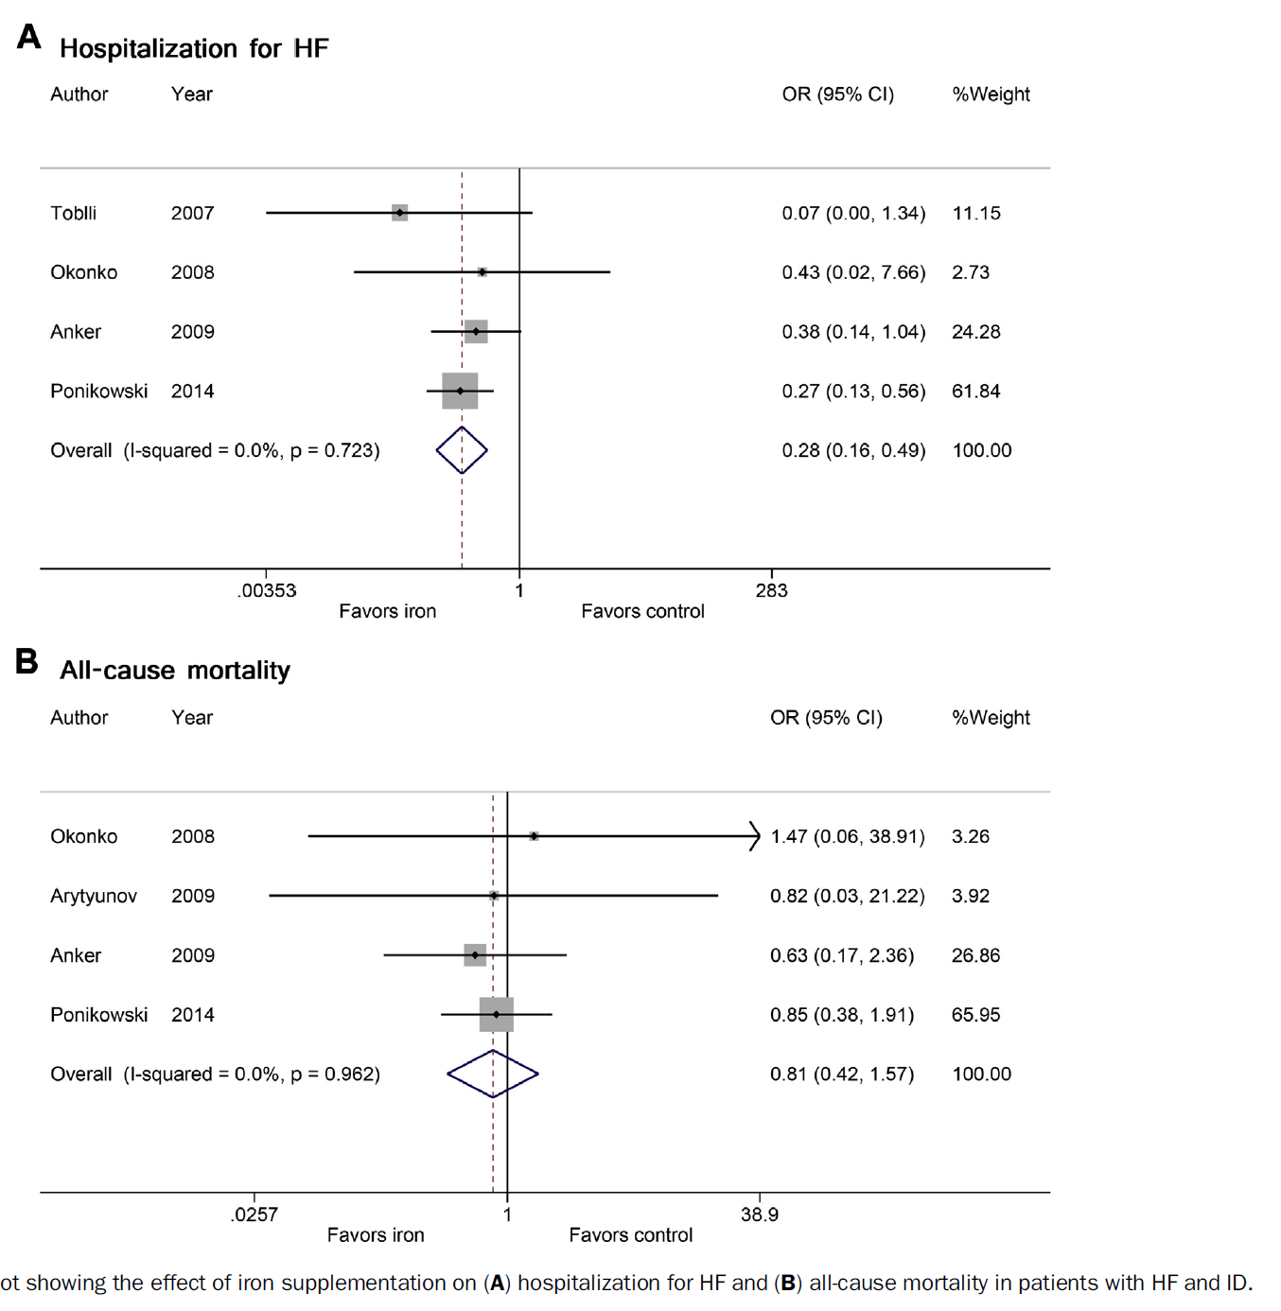

Slide 41
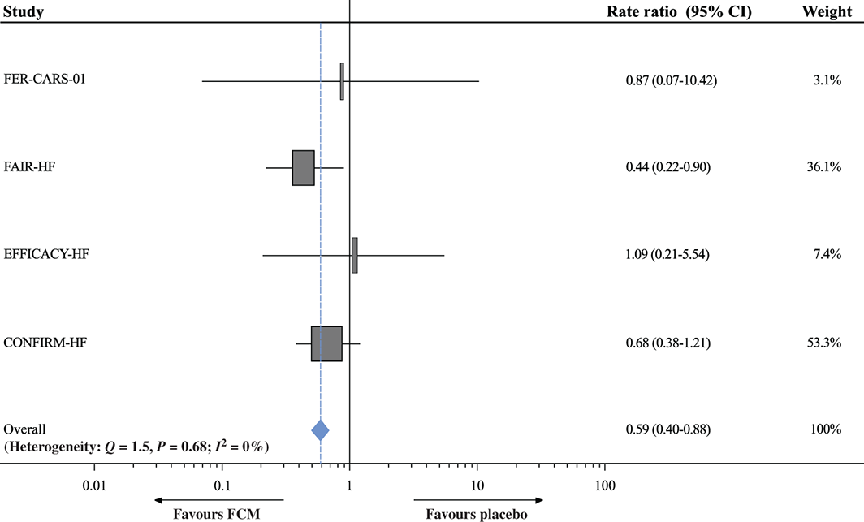
Effects of ferric carboxymaltose on hospitalisations and mortality rates in iron‐deficient heart failure patients: an individual patient data meta‐analysis
European Journal of Heart Failure 24 APR 2017 DOI: 10.1002/ejhf.823
Notes:
Rate ratios for cardiovascular hospitalisations and cardiovascular mortality for the individual randomised controlled trials included in this meta‐analysis. CI, confidence interval; FCM, ferric carboxymaltose.
IF THIS IMAGE HAS BEEN PROVIDED BY OR IS OWNED BY A THIRD PARTY, AS INDICATED IN THE CAPTION LINE, THEN FURTHER PERMISSION MAY BE NEEDED BEFORE ANY FURTHER USE. PLEASE CONTACT WILEY'S PERMISSIONS DEPARTMENT ON PERMISSIONS@WILEY.COM OR USE THE RIGHTSLINK SERVICE BY CLICKING ON THE 'REQUEST PERMISSIONS' LINK ACCOMPANYING THIS ARTICLE. WILEY OR AUTHOR OWNED IMAGES MAY BE USED FOR NON-COMMERCIAL PURPOSES, SUBJECT TO PROPER CITATION OF THE ARTICLE, AUTHOR, AND PUBLISHER.

Slide 47
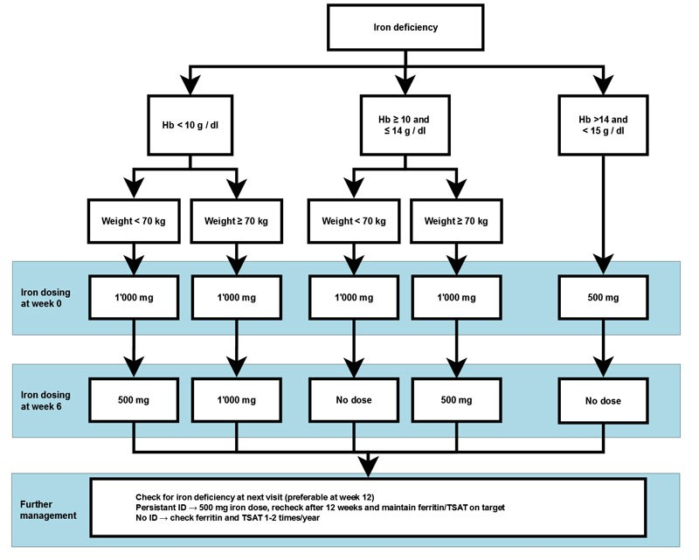

Slide 48
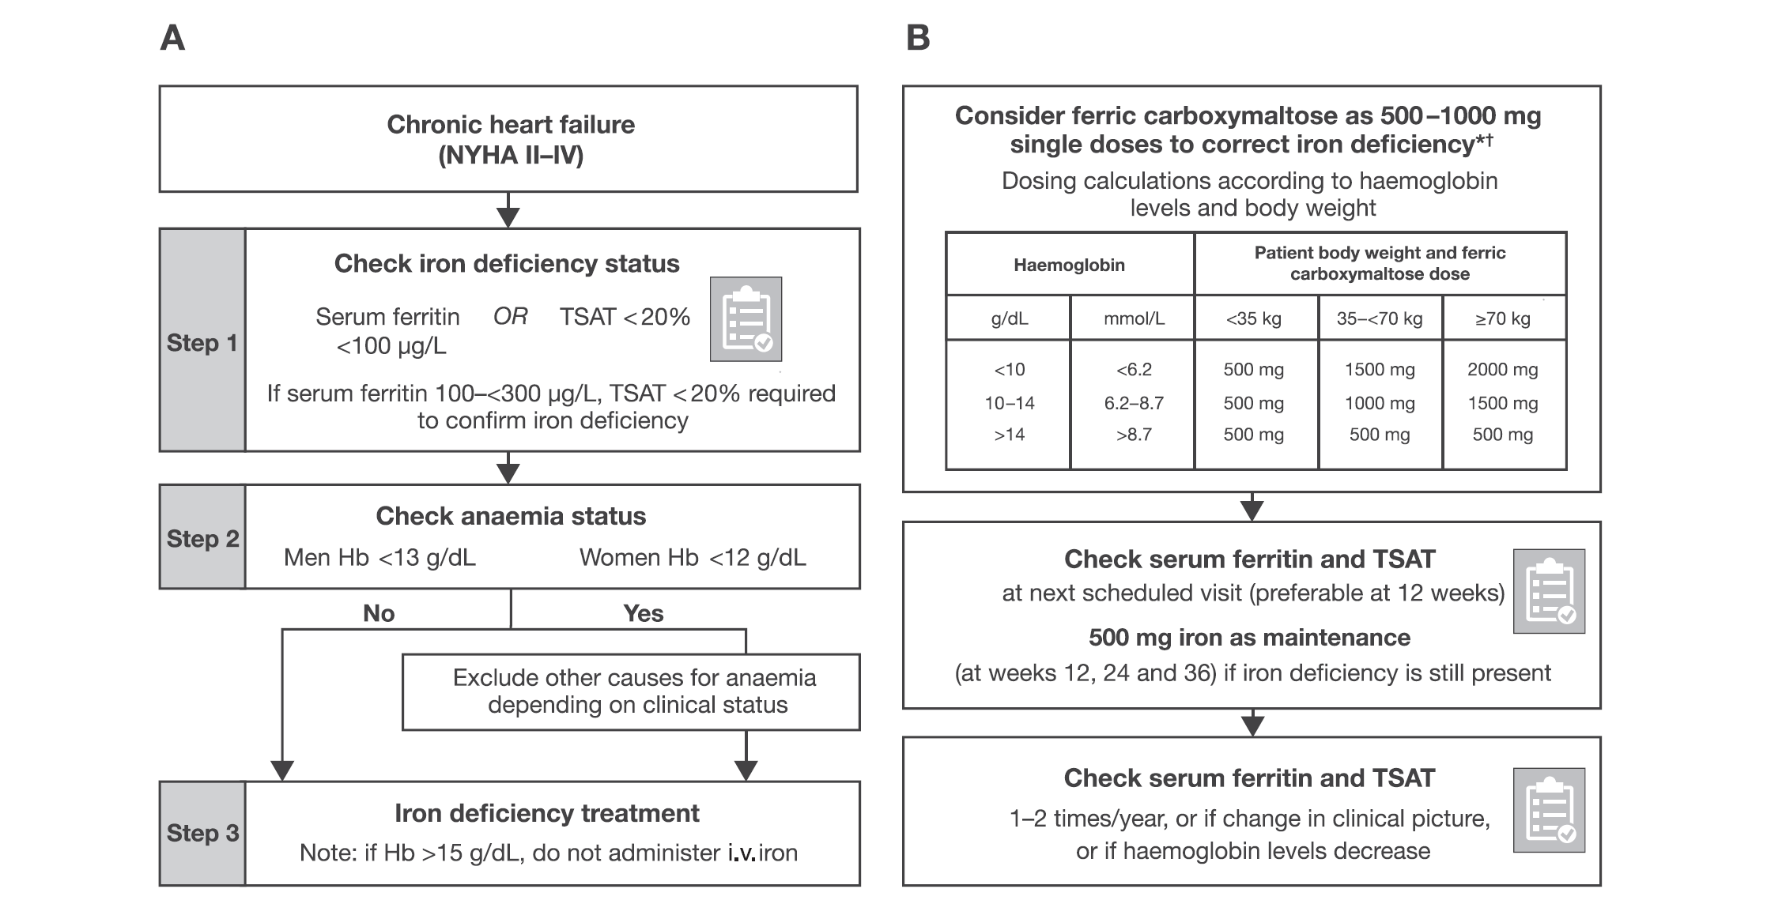

Slide 49
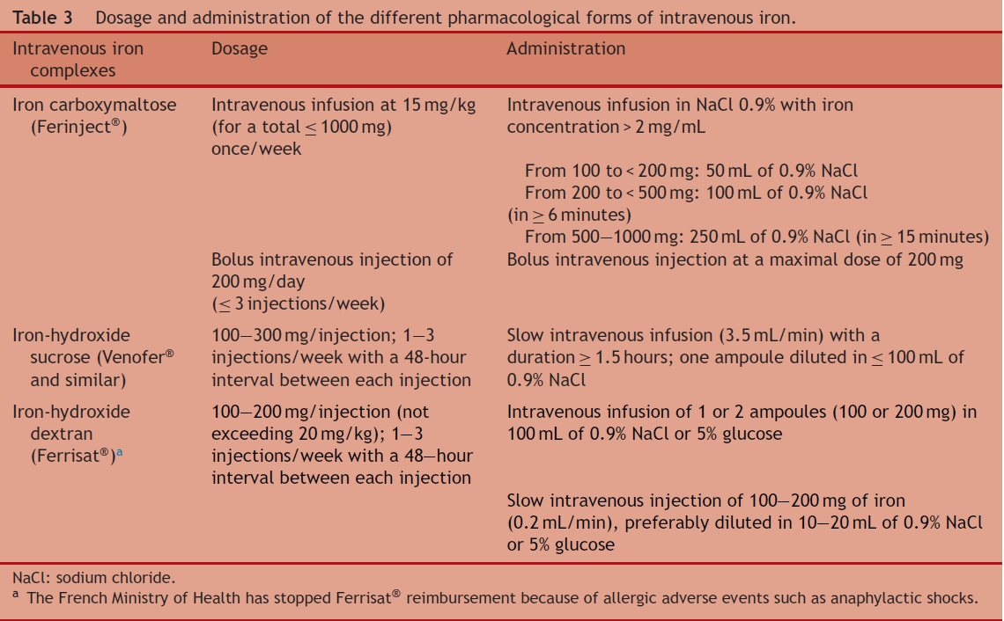

Slide 50
Iron therapy in HF Unanswered questions
Large-scale trials?
Prognosis?
Long-term safety?
Who really benefits?
Hb target in anemia?
Hb restoration rate?

Slide 51
ID in HF: Ongoing trials

Slide 53
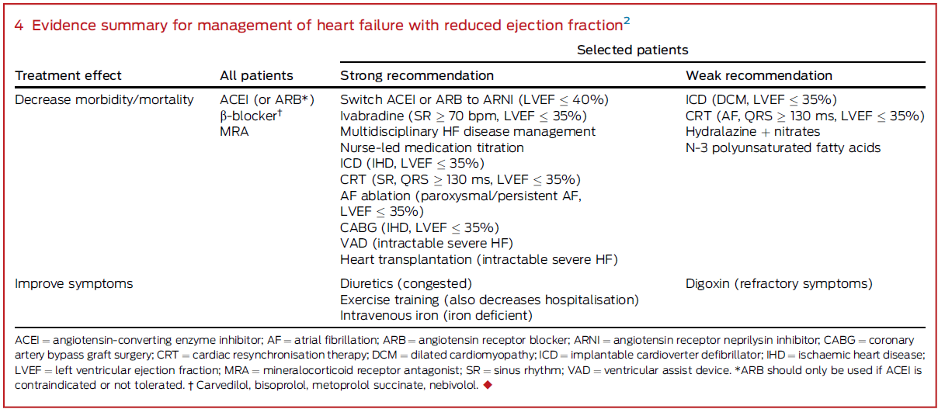

Slide 54
THANK YOU FOR ATTENDING

